Slide 1
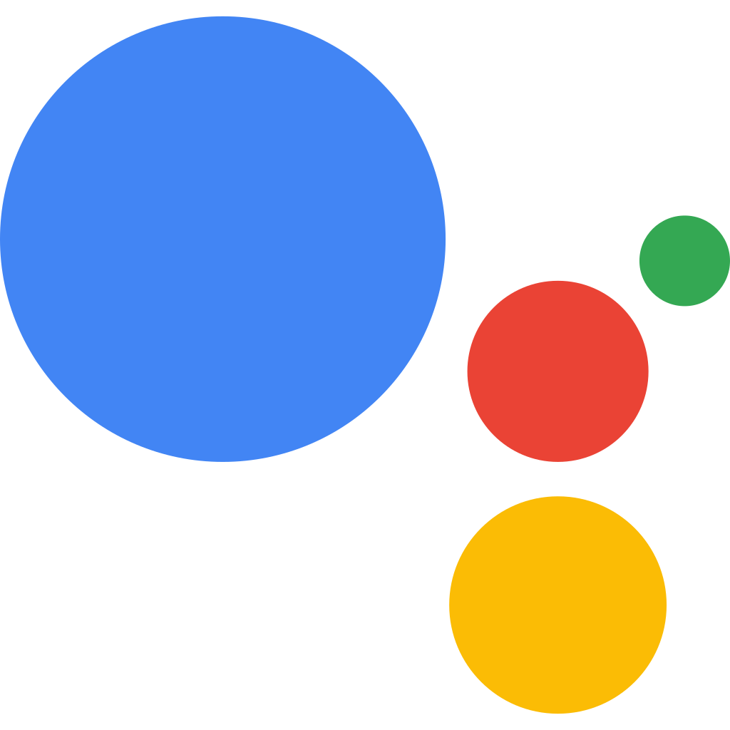
Hey Google! Tell me more about NLP.

Slide 2


Introduction
BRIAN
JISHNU

Slide 3
About GDSC NUS
OUR MISSION
To cultivate empathetic & passionate learners of technology while equipping them with relevant skills and industry insights.
OUR VISION
We strive for the betterment of society through technology

Slide 4

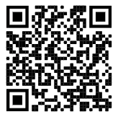
Past workshops
DSC NUS Youtube channel

Slide 5




Today’s workshop
Tools of the trade
Classification models
QnA + Quiz!

Slide 6



Today’s workshop
4. Natural Language Processing
5. What is the best restaurant around NUS?
6. How does Instagram identify and tag Covid-19 posts?

Slide 7
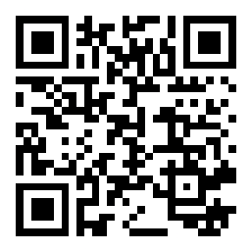
Tools of the trade
Slido QnA (Slido)
Google Colab IDE (Welcome To Colaboratory - Colaboratory)
Scikit-learn code library (scikit-learn: machine learning in Python — scikit-learn 1.0 documentation)
Notes:
Google colab is an online Integrated Development Environment by Google. Through it, we use Google’s cloud computing GPUs to write and execute code in our browsers. We’ll be using Google Colab throughout this workshop to demonstrate machine learning techniques for everyone to code along. We’ll be sending out the link in the zoom chat.
https://app.sli.do/event/mJLuxGmMxmEGXU2kdGxGCu

Slide 8
Basics of Machine Learning
Head to Slido.com and use the code: #471577
Notes:
We’ll be looking at some simple models and analysing the way in which they work, with some examples. At the end, we’ll have a Kahoot quiz on what you’ve learnt before we move on to the next segment

Slide 9
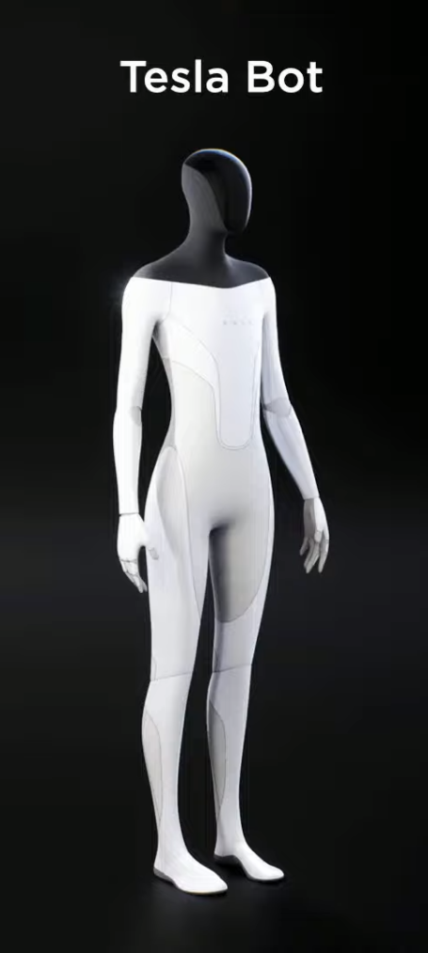

Machine Learning FAQ
Head to Slido.com and use the code: #471577
What is Machine Learning?
Machine learning is the science of developing algorithms that can imitate human learning methods
Machine Learning vs Artificial Intelligence
ML is a subset of AI. AI is the broad science of mimicking human abilities.
Notes:
ML = Netflix recommendations
AI = Tesla Bot type creations

Slide 10
Types of ML models
Head to Slido.com and use the code: #471577
Note: The models are typically named after the algorithms which they use
Regression Models
Classification Models
Reinforcement Learning
Neural Networks
...
Notes:
Briefly explain what these are and how going further, these can be divided into more specific models

Slide 11
The Classification model
Head to Slido.com and use the code: #471577
Different types (K-nearest neighbours, Support Vector machines, Kernel SVM, Naive Bayes, …)

Slide 12
Classification models
Head to Slido.com and use the code: #471577
Requires output to be classifiable/categorical
These outputs are grouped into classes or labels
The model assigns each input an output class based on different criteria
Notes:
Explain what it means for output to be classifiable vs continuous

Slide 13
Classification models
Head to Slido.com and use the code: #471577
Let’s take a look at an example:
You want to create a ML model that can help differentiate between green apples and lemons. How would an SVM model make this differentiation?
Let’s take a look at the SVM model!
Notes:
Explain classifiable vs continuous

Slide 14
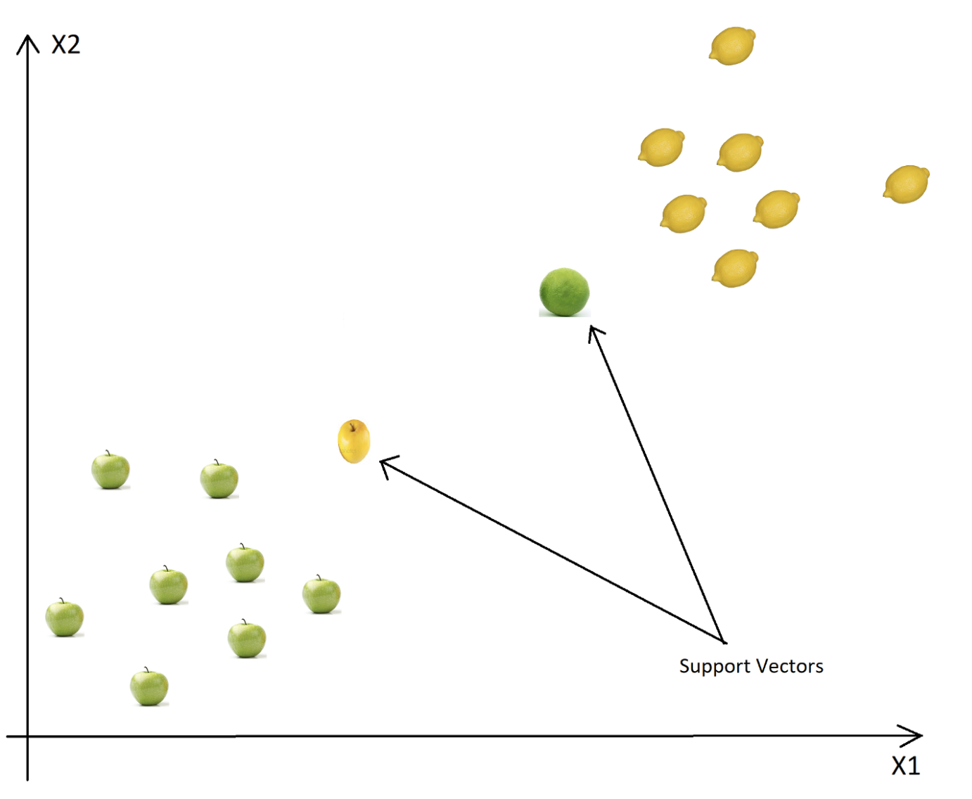
Classification models
Head to Slido.com and use the code: #471577
Support Vector Machine
Texture
Shape
Notes:
X1 and X2 are what are known as Independent Variables (e.g. size, colour, shape, texture)
View the datapoints as vectors from the origin
Choose the most lemon like apple and the most apple like lemon to help make the split
Circle the apples and circle the lemons
Draw the split and explain why it is drawn as such (diff algos can have diff methods for finding the split)

Slide 15
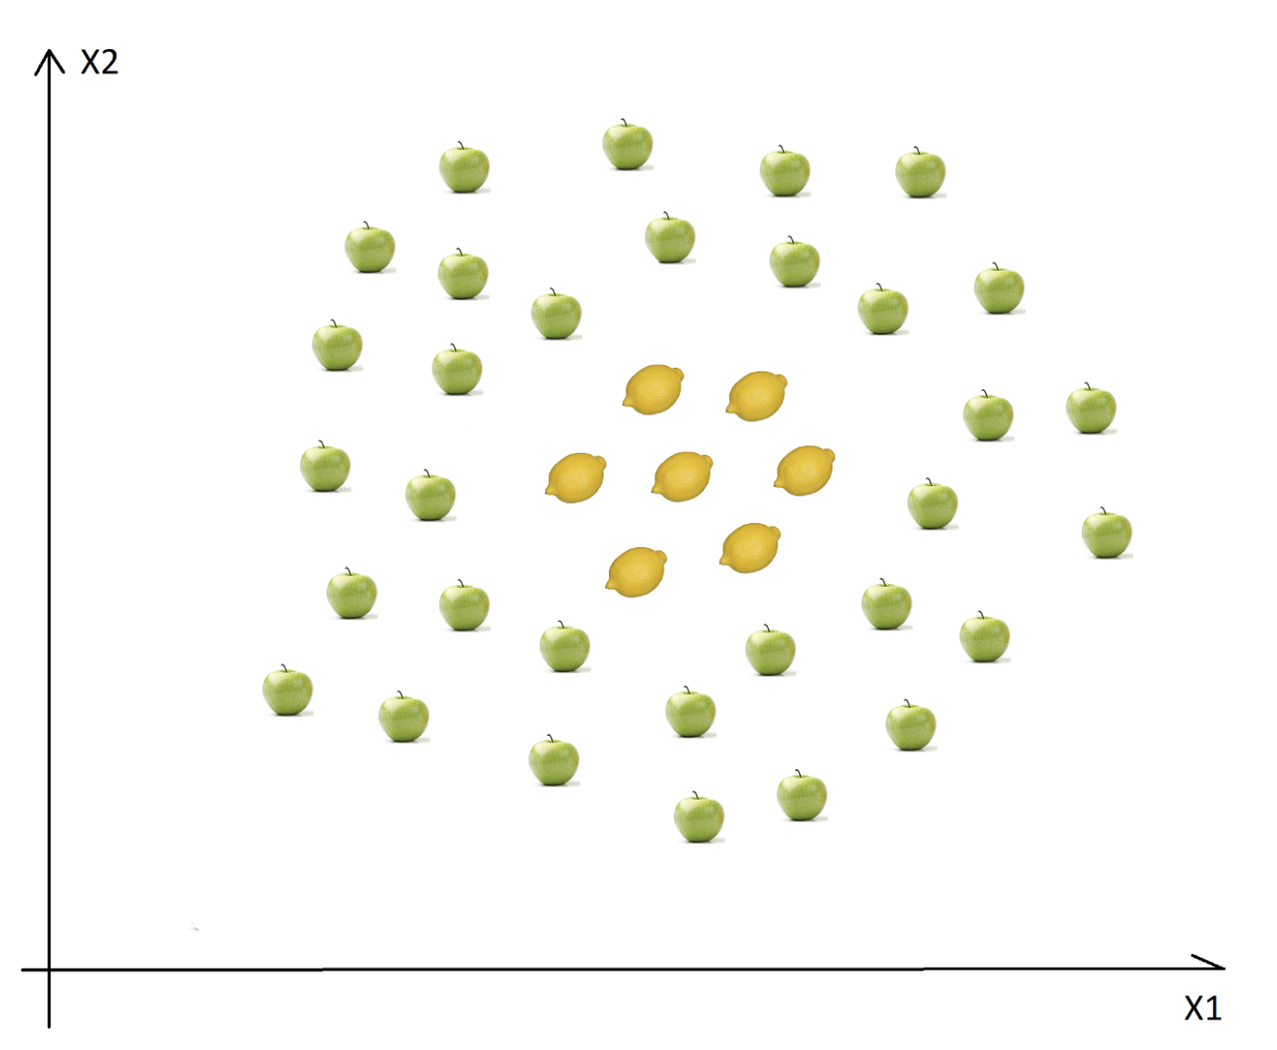
Classification models
Head to Slido.com and use the code: #471577
Kernel SVM
Texture
How do you deal with non-linear data sets?
We apply the kernel trick. This maps the data over to a higher dimension where a linear split can be made
Shape
Notes:
Draw y=x^2 graph on y-x axes and y-x^2 axes

Slide 16
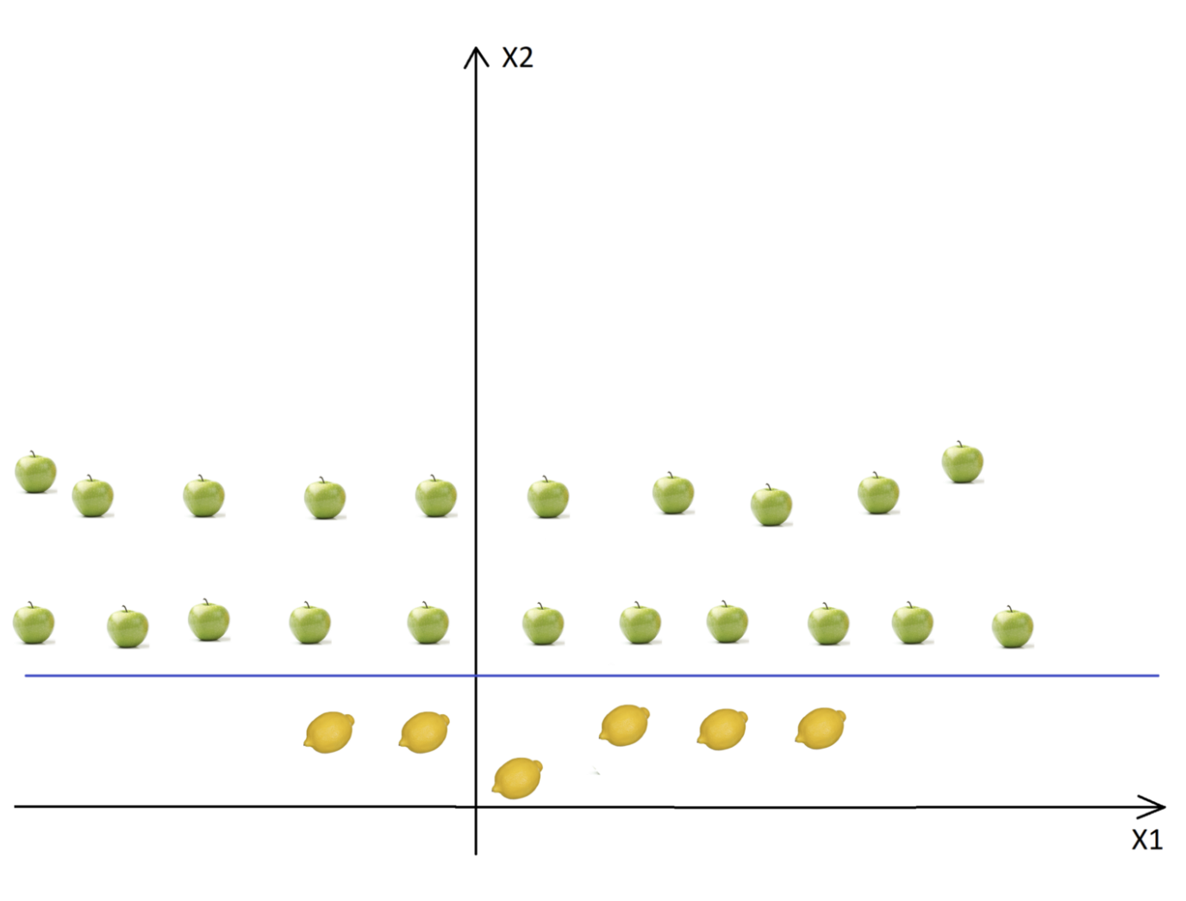
Classification models
Head to Slido.com and use the code: #471577
Kernel SVM
Texture
Texture
Shape
Shape
Notes:
Draw xyz axes first + explain the new axes to focus on
Delete drawing + display diagram
Explain how now it makes it easier for the classification to be visualised and identified
Provide comparison of y-x vs y-x^2 graphs and how we are not adding another variable but just changing the axes

Slide 17
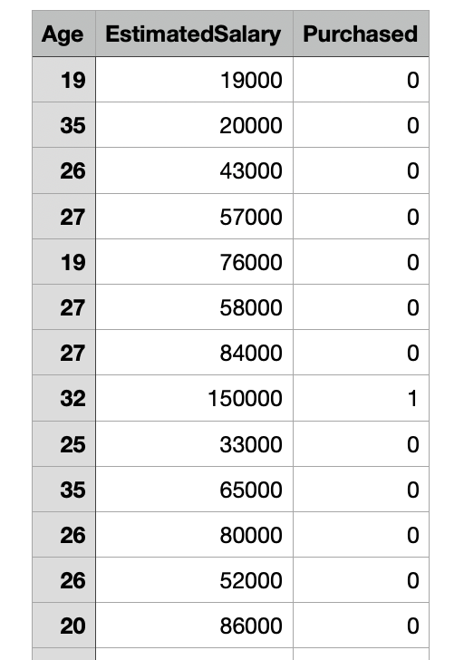
Implementation!
Head to Slido.com and use the code: #471577
Kernel SVM
Imagine you are a data analyst working at Apple…
You have been asked to analyse the probability of a customer purchasing the newest iPhone, given their age and estimated salary.

Slide 18

Types of ML models
Kernel SVM
Use the link in the chat to explore the implementation of this model!
Notes:
Also insert link and qr code in slide
https://colab.research.google.com/drive/1NWdWQ5SeedTVIarZJHaiOQy-9VmgtcTk?usp=sharing

Slide 19
Training Set vs Validation set vs Test Set
Head to Slido.com and use the code: #471577
Training Set
This is the set of data points that your ML model is being trained on
Validation Set
This is a set of data points that you use for a preliminary test of an ML model
Test Set
This is the actual dataset that your ML model will be tested on
Notes:
Validation set might include some of the questionable inputs, that help to solidify the model

Slide 20
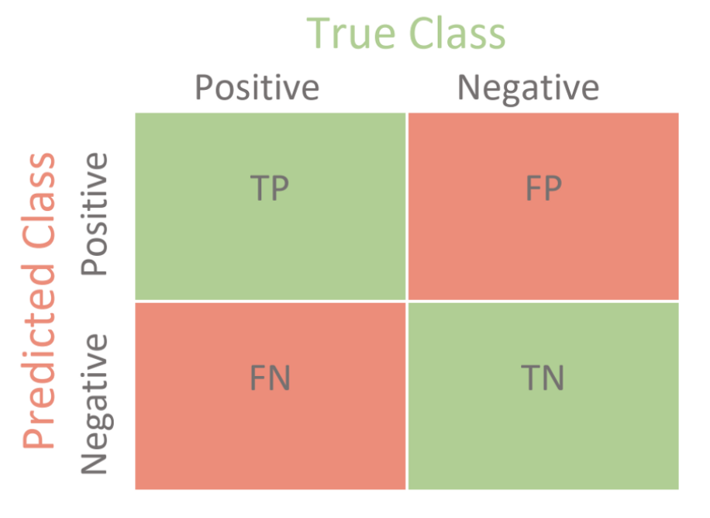
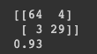
Confusion Matrix
Head to Slido.com and use the code: #471577
Notes:
Spell out the notes

Slide 21
Classification models
Head to Slido.com and use the code: #471577
Naive Bayes
Texture
Step 1: Plot the existing data
Step 2: Add the new input data point to the plot
Shape
Notes:
The NB model, is not concerned with the linearity of the attributes in the dataset

Slide 22
Classification models
Head to Slido.com and use the code: #471577
Naive Bayes
Texture
Step 1: Plot the existing data
Step 2: Add the new input data point to the plot
Shape
Notes:
The NB model, is not concerned with the linearity of the attributes in the dataset

Slide 23
Classification models
Head to Slido.com and use the code: #471577
Naive Bayes
Texture
Step 1: Plot the existing data
Step 2: Add the new input data point to the plot
Step 3: ‘Draw’ a circle of radius, r around the new point
Shape
Notes:
The NB model, is not concerned with the linearity of the attributes in the dataset

Slide 24
Classification models
Head to Slido.com and use the code: #471577
Naive Bayes
Texture
Step 1: Plot the existing data
Step 2: Add the new input data point to the plot
Step 3: ‘Draw’ a circle of radius, r around the new point
Step 4: Count the number of data points within the circle that fall under each output class
No. of yellow lemons: 3
No. of green apples: 9
Total no. of data points: 12
Shape
Notes:
Draw to count

Slide 25
Classification models
Head to Slido.com and use the code: #471577
Naive Bayes
Texture
Texture
Step 1: Plot the existing data
Step 2: Add the new input data point to the plot
Step 3: ‘Draw’ a circle of radius, r around the new point
Step 4: Count the number of data points within the circle that fall under each output class
Step 5: Calculate the probability of the new input data point producing an output of either class
P(lemon) = 3/12 = 25%
P(apple) = 9/12 = 75%
Shape
Shape
Notes:
The NB model, is not concerned with the linearity of the attributes in the dataset

Slide 26
Classification models
Head to Slido.com and use the code: #471577
Naive Bayes
Texture
Texture
Step 1: Plot the existing data
Step 2: Add the new input data point to the plot
Step 3: ‘Draw’ a circle of radius, r around the new point
Step 4: Count the number of data points within the circle that fall under each output class
Step 5: Calculate the probability of the new input data point producing an output of each class
Step 6: Assign the predicted output to be the most likely output based on the calculations in step 5
Predicted Output: Apple
Shape
Shape
Notes:
The NB model, is not concerned with the linearity of the attributes in the dataset

Slide 27
Things to note!
Head to Slido.com and use the code: #471577
The ML model does not actually draw circles, it merely uses the distance between points and compares them with the radius of the circle (thus the model is not restricted to 2 dimensions)
The magnitude of the radius can affect the values of the predictions, especially for more questionable inputs or complex datasets

Slide 28
Q&A
Head to Slido.com and use the code: #471577
Drop your questions on Slido and we’ll answer them! :)

Slide 29
Kahoot Quiz

Slide 30
Natural Language Processing
What is Natural Language Processing and how is it used?

Slide 31
Natural Language Processing
Head to Slido.com and use the code: #471577
What is NLP?
It is about enabling machines to understand and generate human language, in the way a human might.
Where is NLP used?
Voice assistants, translators, speech to text converters, fake-news detectors, search engines!
Notes:
NLP - understand, generate human language/words, pattern recognition from speech as well to construct a meaning out of it

Slide 32


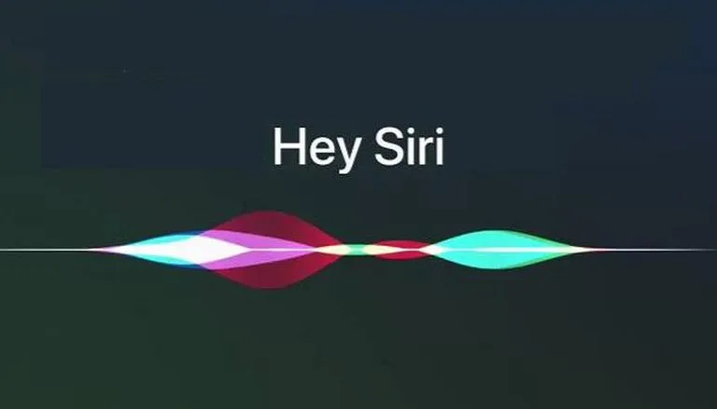
Natural Language Processing in a real-world context
Head to Slido.com and use the code: #471577

Slide 33
Types of NLP models
Head to Slido.com and use the code: #471577
Classical Learning models
Classical learning models use basic ML models like classification and regression models, to analyse and interpret text
These models are trained on large datasets of human language and analyse and they interpret language in significantly different ways from us.
Notes:
Classical learning models -> attach a class label to output, grouping output into categories and using the model to determine the classification for data sets

Slide 34

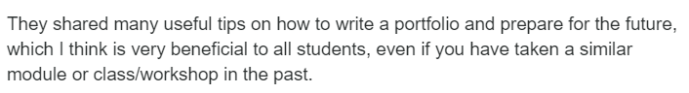
Types of NLP models
Head to Slido.com and use the code: #471577
Classical Learning models
Look at the following sentence:

Slide 35


Classical Learning models
Head to Slido.com and use the code: #471577
Bag of Words model
The ‘bag’ is a list of 20,000 0s [0,0,0,...,0]
Each “0” represents a word in the English language
Useful:
Tips:
Helpful:
Difficult:
Notes:
20,000 is the average number of words used by native English speakers

Slide 36


Classical Learning models
Head to Slido.com and use the code: #471577
Bag of Words model
When the model analyses an input, the ‘bag’ is updated with the new counts for the number of appearances of each word in the input
Useful:
Tips:
Helpful:
Difficult:

Slide 37

Classical Learning models
Head to Slido.com and use the code: #471577
Bag of Words model
By analysing the counts of keywords such as verbs and adjectives, the statement’s net emotion can be evaluated
Positive: 2
Negative: 1
Useful:
Tips:
Similar:
Difficult:
Notes:
For instance, a statement with more positive words is likely to be a positive one while one strewn with vulgarities is unlikely to be a positive one

Slide 38


Code Along with Us!
Head to Slido.com and use the code: #471577
What we will be looking at today:

Slide 39
Classical Learning Models
Head to Slido.com and use the code: #471577
Bag = {“It”:0, “was”:0, “the”:0, “best”:0, “worst”:0; “meal”:0, “I”:0, “ever”:0, “had”:0,...}
Sentence 1: “It was the best meal I ever had”
Updated Bag = {“It”:1, “was”:1, “the”:1, “best”:1, “worst”:0; “meal”:1, “I”:1, “ever”:1, “had”:1, ...}
Sentence 2: “It was the worst meal I ever had”
Updated Bag = {“It”:1, “was”:1, “the”:1, “best”:0, “worst”:1; “meal”:1, “I”:1, “ever”:1, “had”:1, ...}

Slide 40
Classical NLP
Use the link in the chat and create a copy of the file on your computer, to code along with us!
Notes:
Also insert link and qr code in slide
1000Restaurant reviews: https://drive.google.com/file/d/1XvjjGzT0UQZq7rZyhWYMPWey37LpxvzP/view?usp=sharing
NUS restaurant reviews: https://colab.research.google.com/drive/17aU1h12M2b86UaoKGpuANyxsGmMqpHWm?usp=sharing

Slide 41

Disadvantages of this Model
Head to Slido.com and use the code: #471577
Binary outputs (1/0, True/False, Positive/Negative)
Unable to display a wider range of outputs
Notes:
I hope everyone has enjoyed the code along as well as demonstration of our NLP model. Now we’ll be talking about some cons for the NLP model that we showed earlier and when it may not be best suited for a data set.
This model is best used when output is binary -> either true or false, positive or negative, good or bad. But what if we want to measure and predict variable outputs?

Slide 42
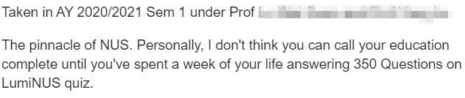
Disadvantages of this Model
Head to Slido.com and use the code: #471577
Does not take into account context/sarcasm

Slide 43
Alternative Models
Other NLP Models & how they are used

Slide 44
Deep NLP Models
Head to Slido.com and use the code: #471577
Another model of Natural Language Processing
What if, instead of supervising our model to learn, we enable it to learn without supervision, similar to how a human learns?
Notes:
Refer to contents of workshop 1 here and note the applications of workshop 1 content

Slide 45

Deep NLP model
Head to Slido.com and use the code: #471577
Another form of Natural Language Processing
Deep NLP learning enables our model to learn unsupervised and recognise patterns in speech/text

Slide 46

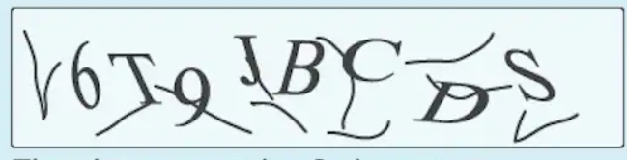

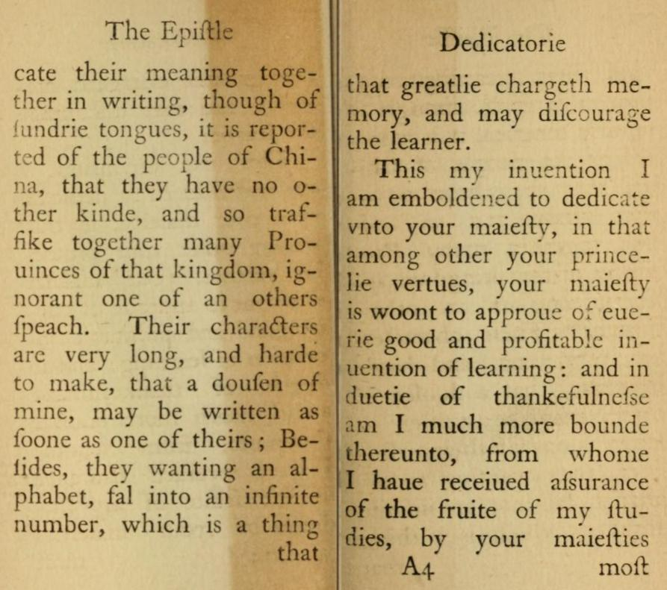
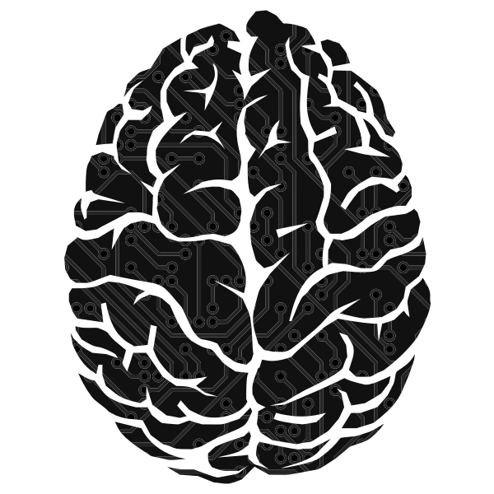

Deep NLP model
Head to Slido.com and use the code: #471577
Captcha: 6 T 9 J B C D S
Book text: …
Sign: Custom text

Slide 47

Latest Developments in NLP
Head to Slido.com and use the code: #471577
Google’s BERT
BERT (Bidirectional Encoder Representations from Transformers), is a new breakthrough in NLP
It considers the context of a word rather than individual words
Notes:
Google aims to improve its search engine with this revolutionary new NLP model - it even is able to deal with the downsides of NLP such as context of individual words, and understand the sentence as a whole - a step closer to better text-to-speech recognition

Slide 48

Latest Developments in NLP
Head to Slido.com and use the code: #471577
Google’s BERT

Slide 49
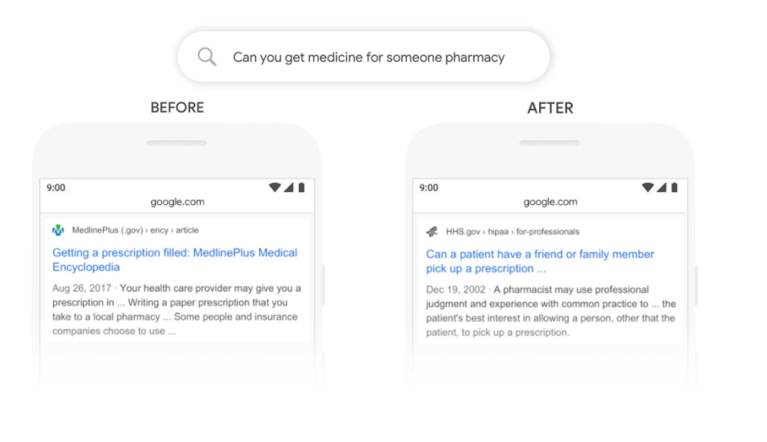
Latest Developments in NLP
Head to Slido.com and use the code: #471577
Google’s BERT

Slide 50
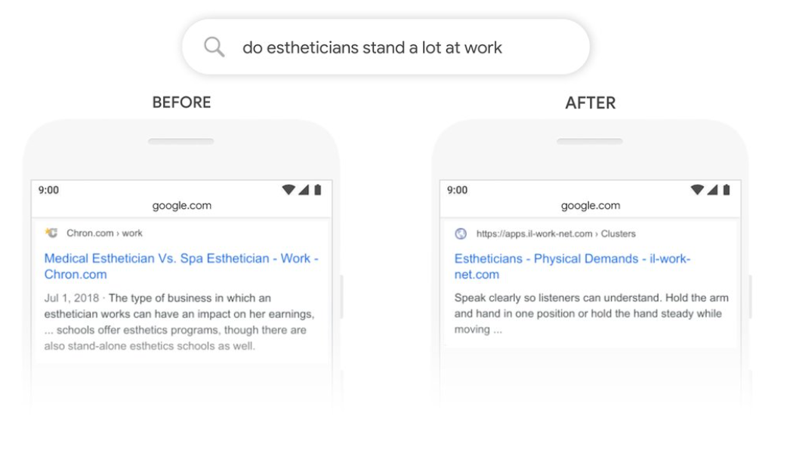
Latest Developments in NLP
Head to Slido.com and use the code: #471577
Google’s BERT

Slide 51
Latest Developments in NLP
Head to Slido.com and use the code: #471577
Google’s BERT
Read more about it here!
https://blog.google/products/search/search-language-understanding-bert/

Slide 52
Q&A
Head to Slido.com and use the code: #471577
Drop your questions on Slido and we’ll answer them! :)

Slide 53
NLP & #TechForGood

Slide 54
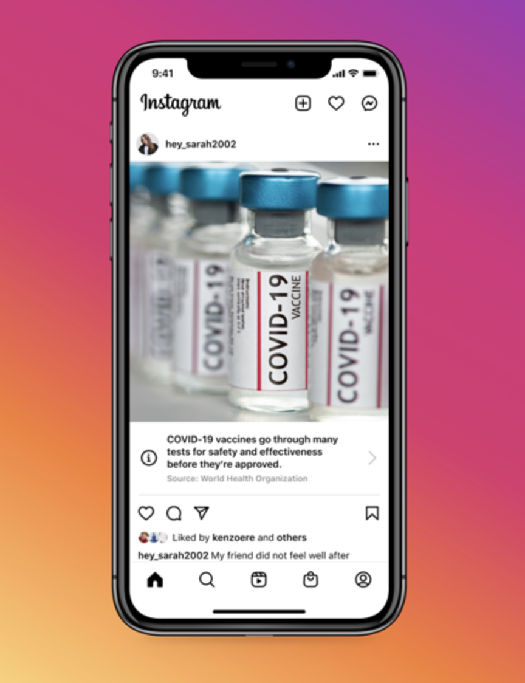
NLP’s application in the pandemic
How does Instagram identify Covid-19 related posts?
Helping People Stay Safe and Informed about COVID-19 Vaccines
Notes:
https://colab.research.google.com/drive/1azWAfPJPuqjCTsbZh_924ewRFWeaz2js?usp=sharing

Slide 55
NLP’s application in the pandemic
We shall now explore 3 different ML models and analyse their accuracy in making correct classifications on our test set of Instagram captions
This will be a code along session so do create a copy of the templates and datasets made available to you and code along with us!

Slide 56
NLP’s application in the pandemic
Support Vector Machine model
What is the filename of your dataset?
Notes:
https://colab.research.google.com/drive/1H43ZrzThDKmzWT4gEWNmxDhtAx60GHsY?usp=sharing

Slide 57
NLP’s application in the pandemic
Naive-Bayes model
What is the name of the missing method used in the prediction step?
Notes:
https://colab.research.google.com/drive/1azWAfPJPuqjCTsbZh_924ewRFWeaz2js?usp=sharing

Slide 58
NLP’s application in the pandemic
Kernel SVM model
Where have I seen this before....
Notes:
https://colab.research.google.com/drive/1mfREnau1zy9wZi854Zg_6UWlrFoSb2QQ?usp=sharing

Slide 59
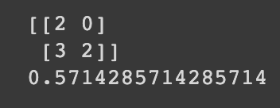
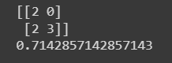
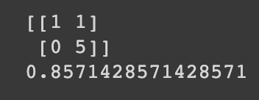
A quick comparison
Kernel SVM model vs SVM vs Naive Bayes
Notes:
https://colab.research.google.com/drive/1H43ZrzThDKmzWT4gEWNmxDhtAx60GHsY?usp=sharing

Slide 60

Thank You for attending!
Do check us out at:
https://dsc.comp.nus.edu.sg/
Past workshops:
https://www.youtube.com/channel/UCo8kiwMbWOqg3fyIfj_9OmQ

